Slide 1
Naïve Bayes Classifier Algorithm
By
Dr. S PADMANABHAN

Slide 2
Naïve Bayes algorithm
Naïve Bayes algorithm is a supervised learning algorithm, which is based on Bayes theorem and used for solving classification problems.
It is mainly used in text classification that includes a high-dimensional training dataset.
Naïve Bayes Classifier is one of the simple and most effective Classification algorithms which helps in building the fast machine learning models that can make quick predictions.

Slide 3
Naïve Bayes algorithm
It is a probabilistic classifier, which means it predicts on the basis of the probability of an object.
It is the fast, accurate and reliable algorithm.
Naive Bayes classifiers have high accuracy and speed on large datasets.
It assumes that the effect of a particular feature in a class is independent of other features.
Some popular examples of Naïve Bayes Algorithm are spam filtration, Sentimental analysis, and classifying articles.

Slide 4
Why is it called Naïve Bayes?
The Naïve Bayes algorithm is comprised of two words Naïve and Bayes, Which can be described as:
Naïve: It is called Naïve because it assumes that the occurrence of a certain feature is independent of the occurrence of other features. Such as if the fruit is identified on the bases of color, shape, and taste, then red, spherical, and sweet fruit is recognized as an apple. Hence each feature individually contributes to identify that it is an apple without depending on each other.
Bayes: It is called Bayes because it depends on the principle of Bayes’ Theorem.

Slide 5

Bayes' Theorem:
Bayes' theorem is also known as Bayes' Rule or Bayes' law, which is used to determine the probability of a hypothesis with prior knowledge. It depends on the conditional probability.
The formula for Bayes' theorem is given as:

Slide 6
Bayes' Theorem:
Where,
P(A|B) is Posterior probability: Probability of hypothesis A on the observed event B.
P(B|A) is Likelihood probability: Probability of the evidence given that the probability of a hypothesis is true.
P(A) is Prior Probability: Probability of hypothesis before observing the evidence.
P(B) is Marginal Probability: Probability of Evidence.

Slide 7
How Naive Bayes Classifier Works?
Let’s understand the working of Naive Bayes through an example. Given an example of weather conditions and playing sports. You need to calculate the probability of playing sports. Now, you need to classify whether players will play or not, based on the weather condition.

Slide 8
First Approach (In case of a single feature)
Naive Bayes classifier calculates the probability of an event in the following steps:
Step 1: Calculate the prior probability for given class labels
Step 2: Find Likelihood probability with each attribute for each class
Step 3: Put these values in Bayes Formula and calculate posterior probability.
Step 4: See which class has a higher probability, given the input belongs to the higher probability class.

Slide 9
For simplifying prior and posterior probability calculation, you can use the two tables frequency and likelihood tables. Both of these tables will help you to calculate the prior and posterior probability.
The Frequency table contains the occurrence of labels for all features.
There are two likelihood tables. Likelihood Table 1 is showing prior probabilities of labels and Likelihood Table 2 is showing the posterior probability.

Slide 10
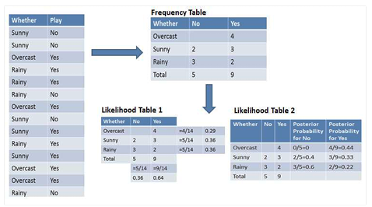

Slide 11
Now suppose you want to calculate the probability of playing when the weather is overcast.
Probability of playing:
P (Yes | Overcast) = P (Overcast | Yes) P(Yes) / P (Overcast) ----- (1)
Calculate Prior Probabilities:
P(Overcast) = 4/14 = 0.29
P(Yes) = 9/14 = 0.64
Calculate Posterior Probabilities:
P (Overcast |Yes) = 4/9 = 0.44
Put Prior and Posterior probabilities in equation (1)
P (Yes | Overcast) = 0.44 * 0.64 / 0.29 = 0.98
Similarly, we can calculate the probability of not playing:

Slide 12
Probability of not playing:
P (No | Overcast) = P (Overcast | No) P(No) / P (Overcast) ------(2)
Calculate Prior Probabilities:
P(Overcast) = 4/14 = 0.29
P(No)= 5/14 = 0.36
Calculate Posterior Probabilities:
P (Overcast |No) = 0/9 = 0
Put Prior and Posterior probabilities in equation (2)
P (No | Overcast) = 0 * 0.36 / 0.29 = 0
The probability of a 'Yes' class is higher.
So, we can determine here if the weather is overcast than players will play the sport.

Slide 13
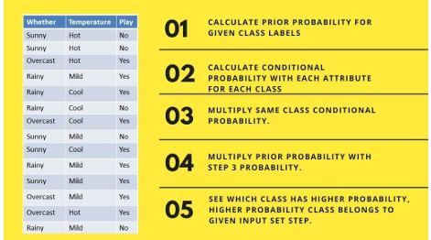
Second Approach (In case of multiple features)

Slide 14
Now suppose you want to calculate the probability of playing when the weather is overcast, and the temperature is mild.
Probability of playing:
P (Play = Yes | Weather = Overcast, Temp = Mild)
= P (Weather = Overcast, Temp = Mild | Play = Yes) P (Play = Yes) -----(1)
P (Weather = Overcast, Temp = Mild | Play = Yes) = P (Overcast |Yes) P (Mild |Yes) -----(2)

Slide 15
Calculate Prior Probabilities: P (Yes) = 9/14 = 0.64
Calculate Posterior Probabilities:
P (Overcast |Yes) = 4/9 = 0.44
P (Mild |Yes) = 4/9 = 0.44
Put Posterior probabilities in equation (2)
P (Weather = Overcast, Temp = Mild | Play = Yes) = 0.44 * 0.44 = 0.1936
Put Prior and Posterior probabilities in equation (1)
P (Play = Yes | Weather = Overcast, Temp = Mild) = 0.1936*0.64 = 0.124

Slide 16
Similarly, we can calculate the probability of not playing:
Probability of not playing:
P (Play = No | Weather = Overcast, Temp = Mild)
= P (Weather = Overcast, Temp = Mild | Play = No) P (Play = No) ------(3)
P (Weather = Overcast, Temp = Mild | Play = No)
= P (Weather = Overcast |Play = No) P (Temp = Mild | Play = No) ------(4)

Slide 17
Calculate Prior Probabilities: P (No) = 5/14 = 0.36
Calculate Posterior Probabilities:
P (Weather = Overcast |Play = No) = 0/9 = 0
P (Temp = Mild | Play = No) = 2/5 = 0.4
Put posterior probabilities in equation (4)
P (Weather = Overcast, Temp = Mild | Play = No) = 0 * 0.4 = 0
Put prior and posterior probabilities in equation (3)
P (Play = No | Weather = Overcast, Temp = Mild) = 0 * 0.36 = 0
The probability of a 'Yes' class is higher.
So, we can say here that if the weather is overcast than players will play the sport.

Slide 18
Advantages of Naïve Bayes Classifier:
Naïve Bayes is one of the fast and easy ML algorithms to predict a class of datasets.
It can be used for Binary as well as Multi-class Classifications.
It performs well in Multi-class predictions as compared to the other Algorithms.
It is the most popular choice for text classification problems.

Slide 19
Disadvantages of Naïve Bayes Classifier:
Naive Bayes assumes that all features are independent or unrelated, so it cannot learn the relationship between features.

Slide 20
Applications of Naïve Bayes Classifier:
It is used for Credit Scoring.
It is used in medical data classification.
It can be used in real-time predictions because Naïve Bayes Classifier is an eager learner.
It is used in Text classification such as Spam filtering and Sentiment analysis.

Slide 21
Types of Naïve Bayes Model:
There are three types of Naive Bayes Model, which are given below:
Gaussian: The Gaussian model assumes that features follow a normal distribution. This means if predictors take continuous values instead of discrete, then the model assumes that these values are sampled from the Gaussian distribution.
Multinomial: The Multinomial Naïve Bayes classifier is used when the data is multinomial distributed. It is primarily used for document classification problems, it means a particular document belongs to which category such as Sports, Politics, education, etc. The classifier uses the frequency of words for the predictors.

Slide 22
Types of Naïve Bayes Model:
Bernoulli: The Bernoulli classifier works similar to the Multinomial classifier, but the predictor variables are the independent Booleans variables. Such as if a particular word is present or not in a document. This model is also famous for document classification tasks.

Slide 23
Python Implementation of the Naïve Bayes algorithm:
Steps to implement:
Data Pre-processing step
Fitting Naive Bayes to the Training set
Predicting the test result
Test accuracy of the result(Creation of Confusion matrix)
Visualizing the test set result.

Slide 24
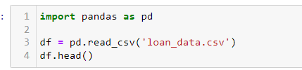
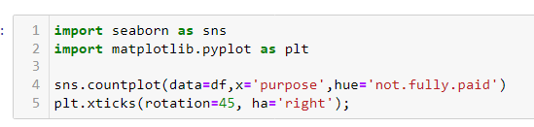

Python Implementation of the Naïve Bayes algorithm:

Slide 25
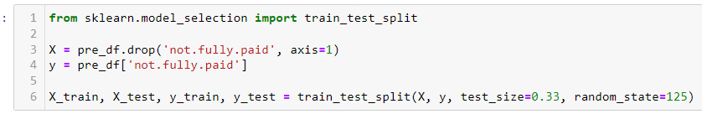
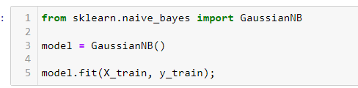

Python Implementation of the Naïve Bayes algorithm:

Slide 26
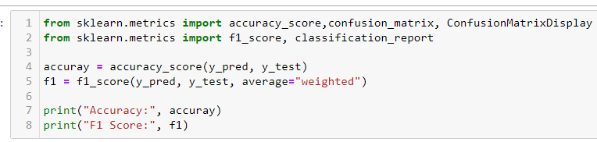
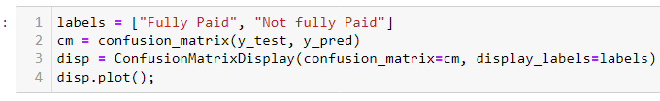
Python Implementation of the Naïve Bayes algorithm:

